Slide 1
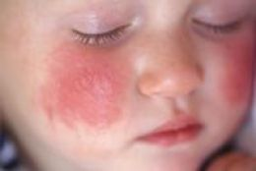
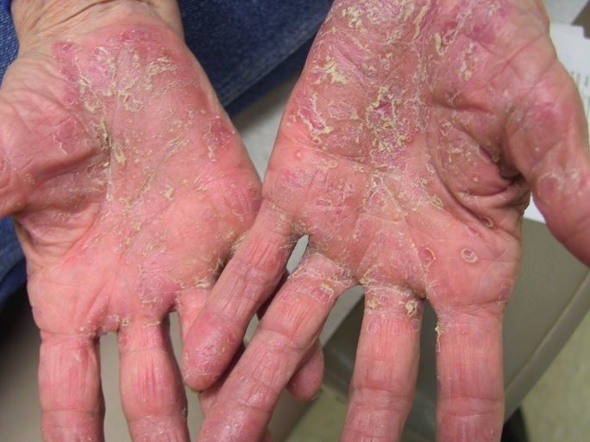
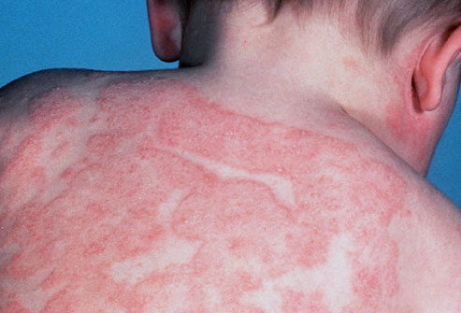
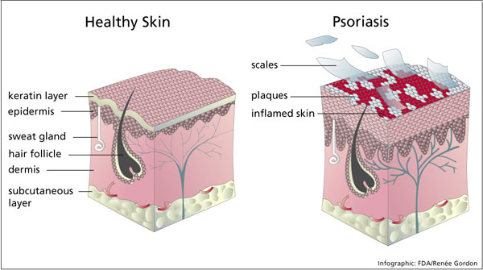
Inflammatory Skin Conditions Eczema, Psoriasis, Rosacea
Dr Steve Chaney, Barbara Lagoni
Jo Coogan

Slide 2
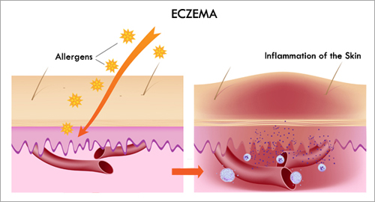
Incidence of Skin Disorders
Eczema – inflammatory skin condition affects about 31 million Americans… about 11% of infants and children (NationalEczema.org )
Rosacea – 16 million Americans ( especially high in North East )
Psoriasis – chronic, immune-mediated, inflammatory disease which primarily affects the skin and joints… 2% of US population affected (6.3 million)
barb

Slide 3
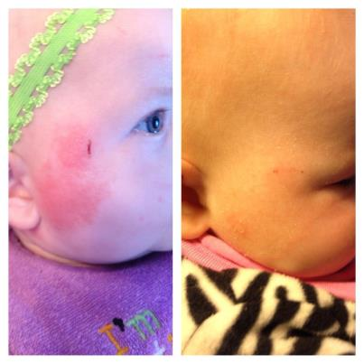
Reese Bagwell – Born C- Section
Diagnosed with eczema at 3 month old .. Also reflux
Prescribed Zyrtec and steroid cream– uncomfortable with side effects ( penetrates into blood stream, permanently change pigmentation of skin .. Was on her face .. )
Began using Shaklee – -- --Optiflora Capsule ( soaked in water and removed outer coating ),
-- Crushed Alfalfa ( also helped infant reflux )
-- Incredivites ( 1/4 tablet )
-- Nutriferon ( 1/4 tablet )
-- Bathed in Basic H
-- Get Clean Fresh Laundry products ( flared after visiting grandparents using Gain Laundry product)
Cleared up 3 days !
At 20 months now on Omega Guard ( Mighty Smarts )

Slide 4
Barbara Taylor 6-Year Old Daughter --Eczema
Eczema her entire life
Tried every prescription cream, over-the-counter cream, coconut oil, Aqua-phor, .. Nothing helped
Large patches of dry red skin on hands and wrists and small spots on other spots of her body.
Started on Shaklee vitamins just to take a vitamin to be healthy ..had no idea it would help the eczema.
Optiflora Probiotic
Vita Lea Multi
Switched to Shaklee Get Clean cleaning and laundry products
Spots began fading after a month
Added Alfalfa – completely clear since
Went out-of-town over Spring Break in March without supplements – began to return. Now completely clear again … and she is one happy 6-year-old.

Slide 5
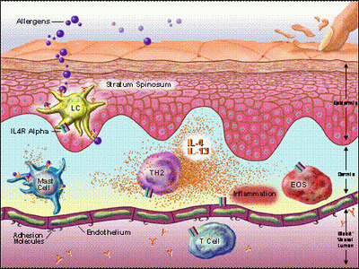
Factors That Cause or Aggravate Eczema – Atopic Dermatitis
Food allergens-- cow’s milk, eggs, gluten (wheat, barley, rye & oats), soy, peanuts, fish, beef, corn, citrus and even tomatoes.
Stress
Genetics ( inability to convert essential fatty acids )
Antibiotics and toxic ingredients like heavy metals ( vaccinations ).
Caustic and toxic detergents or fabric softeners can aggravate and worsen eczema symptoms.
High fat, “fast food” and other processed foods
“A recent finding published in the journal, Thorax, claims that “kids who eat fast food three or more times a week are likely to have more severe allergic asthma, hay fever and eczema.” There’s little to no nutritional value in these sorts of foods. In fact they tax the immune system.”
Exposure to environmental allergens like dust, animal dander and pollen. In fact, many kids that have eczema may also develop asthma and hay fever.
steve

Slide 6


4 Steps To Healthy Skin
#1 Health the gastro-intestinal system
#2 Provide nutrients body needs to make healthy skin
#3 Reducing inflammation and normalizing the immune system
#4 Eliminate toxins and irritants .. Cleaning products, laundry products, use of toxic chemicals in the home and garden, eat organic ,etc
barb

Slide 7
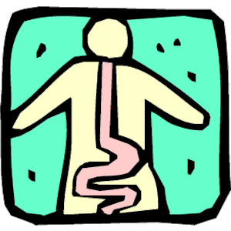
# 1 To Treat Eczema Naturally – A Healthy Gut
Topical treatments will not solve the problem -- first heal the gastro-intestinal system
“The gut is the door through which a majority of disease initiates its entrance into the body. Naturopaths Drs
“It goes without saying that many factors in today’s lifestyle compromise the meticulous integrity of the gut lining, namely food choices and antibiotic therapies. The first area of treatment then for the patient displaying eczema should be the gastrointestinal lining. “ steve

Slide 8
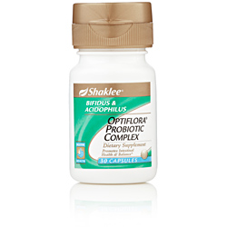
Heal the Gut
Optiflora Probiotics help re-build friendly bacteria in the gut; help fight bad bacteria that cause inflammation and health issues.
Probiotic supplementation in pregnant women helps prevent babies from developing eczema. (Naturopathic Doctor’s Chris D. Meletis, ND, and Jason Barker, ND )
Eczema may also be a symptom of something called Leaky Gut Syndrome – a condition that affects the lining of the intestines. ( often caused by Candida over-growth & diet high in refined carbohydrates )
.
steve

Slide 9

Unique, Patented “Triple Encapsulation” Technology Protects “Live” Microflora
Supports healthy immune system
& healthy digestion
“Live” microflora
Water and oxygen barrier
Stomach acid protection
500 million friendly bacteria/capsule
Triple encapsulation process → 90% delivery
OPTIFLORA™ completely survives stomach acid. Microflora are then released in the intestine. han
steve

Slide 10

Optiflora Probiotic System
Restores beneficial micro-organisms to lower intestines
lost from antibiotics, diarrhea, chemotherapy, steroids, and other medications
Keeps undesirable bacteria & yeasts in check
Strengthens the immune system (80% is in the gut)
Triple encapsulation
protects acidophilus, bifidus, and
other probiotics from stomach acids
steve

Slide 11

# 2 Eczema – Feed the Body the Nutrients It Needs Avoid Foods That Increase Inflammation
Eat a fresh natural food, with whole and organic foods ( fresh vegetables, fruits, nuts, walnuts, flax seeds, chia seeds, pumpkin seeds, poultry, legumes )
Avoid processed foods, caffeine, dairy, gluten, meat, sugar and alcohol.
Food allergen testing reveals if there’s anything else you should avoid. Even some fruits or vegetables could be a culprit.
Drink at least 64 ounces of water a day. ( 2 quarts )
barb

Slide 12
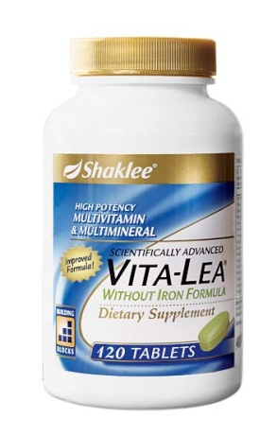
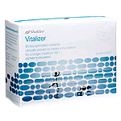
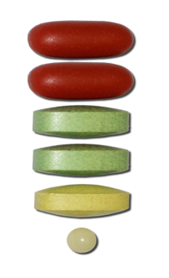
Provide Nutrients Essential for the Skin
Vitamins and minerals are essential for healthy skin .. Especially :
Vitamins D ( 1000-1200 IU )
B Complex
Vitamin C– anti-inflammatory, anti-oxidant, antibiotic properties
Vitamin E --protects intestinal cells from oxidative stress
Zinc
Carotenoids
Omega-3s
For children:
Incredivites --complete multi, no artificial anything
For adults: Vitalizer
Complete multi with omega-3s, carotenoids, etc
steve
Or: Vita-Lea
Complete multi vitamin
Multi-mineral , economical

Slide 13
Shaklee’s INCREDIVITES™
Supernutritious:
First kids’ chewable multi in the U.S. with immune-supporting power of lactoferrin!
23 Essential Nutrients—Needed for proper growth and development
600 IU of Vitamin D₃, Support for strong bones and teeth
Supersafe:
Naturally sweetened with xylitol, which does not promote cavities
No artificial flavors, sweeteners, or preservatives
Great Tasting, Kid Tested, and Kid Approved!
All-natural tropical punch, grape, and berry flavors.
barb

Slide 14
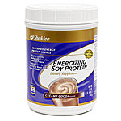
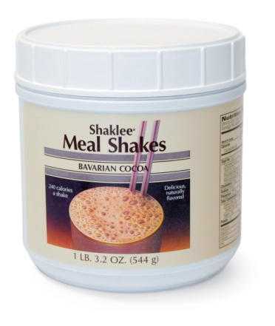
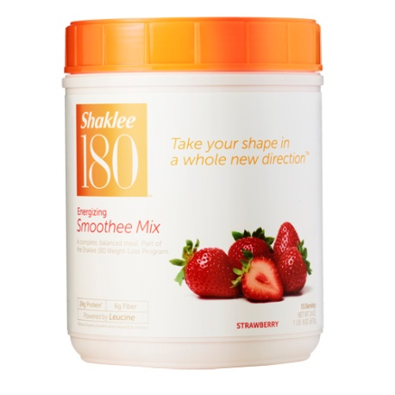
Protein –Essential for Building Healthy Skin Cells
Energizing Soy or Shaklee 180 Smoothees
Or Mealshake Creamy Whey Shakes
Good protein sources, low in fat & cholesterol, balanced nutrition
1/3 of all essential nutrients
Soy or whey
Clinically proven to stabilize blood sugar levels
Great tasting
Non- GMO
barb
Peanut Butter Fudge ( 1 cup peanut butter, 1 cup Energizing Soy Protein, 1/3 cup honey )

Slide 15
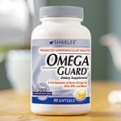
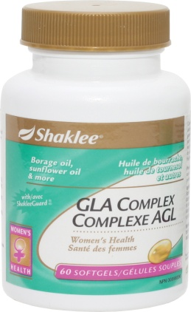
# 3 Eczema – Reduce Inflammation & Normalize the Immune System –
Essential Fatty Acids – DHA, EPA and GLA
Some people with eczema have an inability to metabolize short chain omega 3 fatty acids (ie. from vegetable oils) to the long-chain fatty acids of DHA and EPA
Help reduce inflammation
Promote a healthy immune response
Improve the barrier function of the skin and is vital for keeping skin cells moist and strong steve
,
Keep a 2:1 ratio of DHA and EPA ( the long chain EFA to GLA )

Slide 16

MIGHTY SMART™ Chews
Supersmart:
High in DHA Omega-3s for BrainPOWer
DHA helps support concentration, memory, and vision
100 mg per serving—A level clinically proven to increase blood levels of DHA in children ages 4–12
Supersafe:
Certified organic by Quality Assurance International
100% natural, ultra-pure DHA
No artificial colors, sweeteners, or preservatives
Great Tasting, Kid Tested, and Kid Approved! Yummy Orange Chew
steve

Slide 17
Omega 3 Fatty Acids… Shaklee Omega Guard
Ultra pure, pharmaceutical grade, full spectrum of 7 Omega 3 fatty acids
Reduces risk of heart disease and stroke
Improves eczema, colitis, arthritis, MS, psoriasis, migraines, reduces C-reactive protein,
Important for brain, eyes, joints, helps ADD & ADHD, memory loss and depression
steve

Slide 18
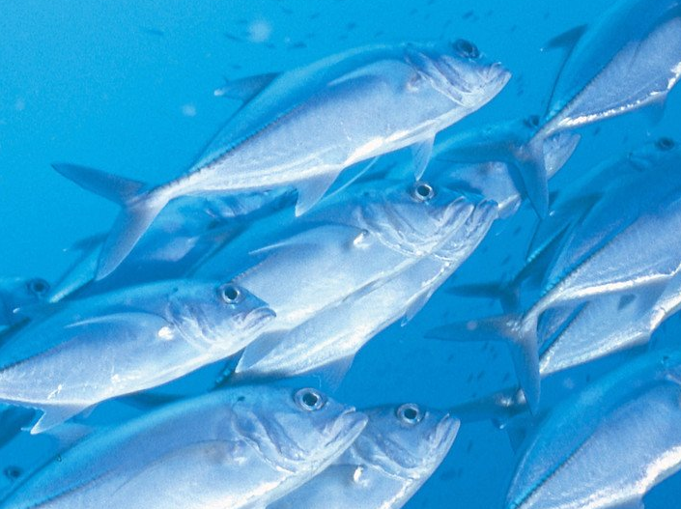

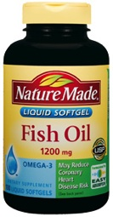
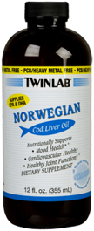
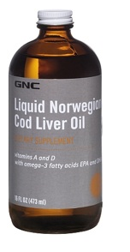

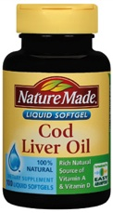
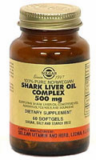
Omega 3 Fish Oil ALWAYS SAFE Industrial Pollutants –PCB’s
“Lawsuit: Disclose PCB Levels in Fish Oil. Group Finds Amount of Contaminant Varies Greatly Among Popular Supplement Brands” - CBS May 2, 2010
steve

Slide 19

Nutriferon: Normalizes for Immune System
4 herbal extracts that stimulate the body’s own production of interferon .. naturally.
No side effects ( unlike pharmaceutical interferon )
Developed by Nobel Prize winning immunologist,
Dr. Kojima
4 published clinical studies
Reduced hepatitis C virus by 1/3 in 4 weeks
Significantly reduces allergy symptoms
In the case of auto-immune conditions, start Nutriferon slowly.
barb

Slide 20
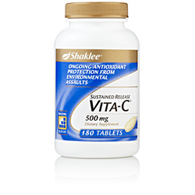
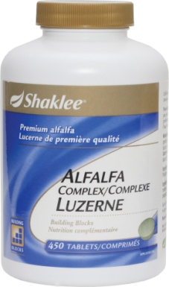
Chewable Vita C
Alfalfa Complex
Essential for healthy immune system
Helps reduce damaging effect of air pollution
Dissipates in air, heat and light
Higher levels recommended for allergies, asthma, healing, prevention of colds, viruses, flu.. Especially important for additional immune protection when school starts.
One of the healthiest foods
Deep roots draw up trace minerals from the soil plus important anti-oxidants
Natural decongestant and anti-histamine
Popularly used for allergies, congestion and sinus issues, soothing to the stomach
barb

Slide 21
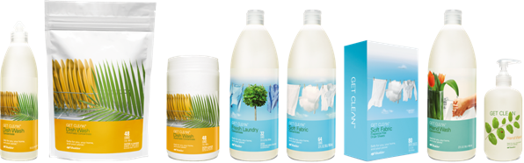


#4 Avoid Toxins and Irritants
Use Natural personal care products, laundry detergents
Get Clean Fresh Laundry Concentrate & Fabric Softener --
Enfuselle Skin Care Products--
Conventional personal care products contain many harmful ingredients that your skin can absorb– you will eliminate many toxins from entering your body. The same holds true for laundry detergents and softeners. Shaklee Fresh Laundry and Personal Care Products .
barb

Slide 22
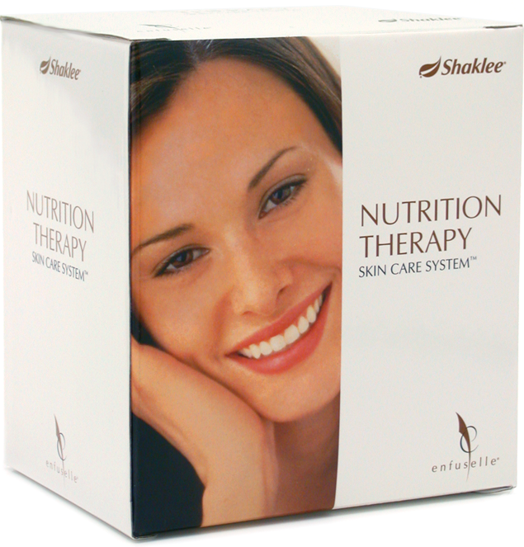
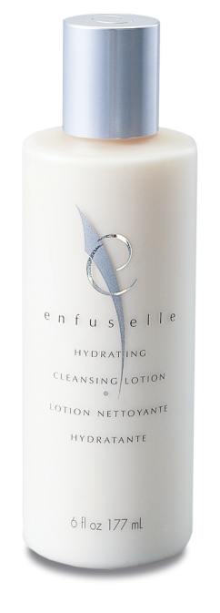
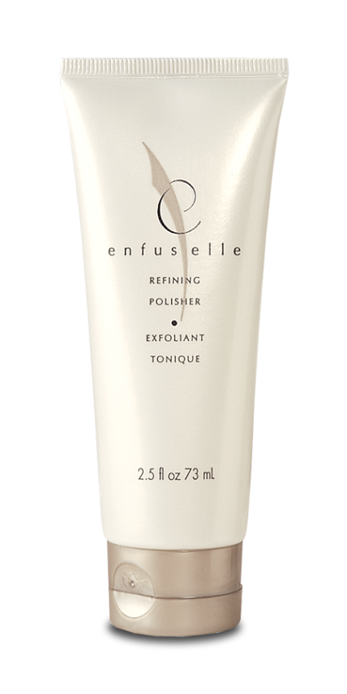
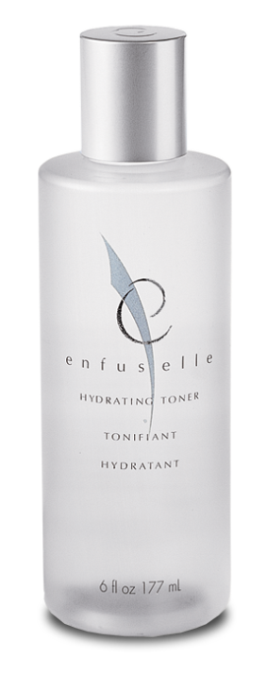
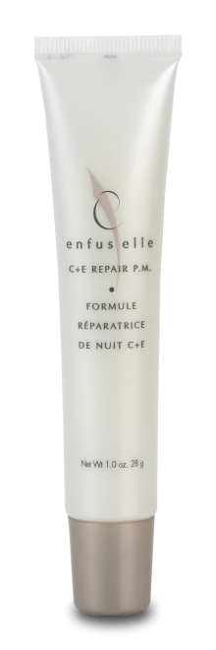
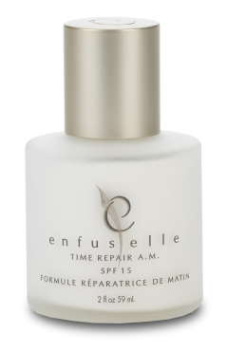
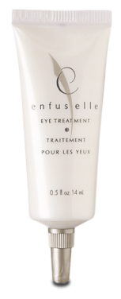

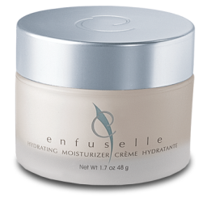
Eliminate Toxins and Irritants
Enfuselle Nutrition Therapy Skin Care System™ and Shaklee Personal Care Line
Enfuselle® blocks ALL skin-damaging free radical reactions
barb
The difference is immediate. Skin will look dramatically firmer with fewer wrinkles in 28 days–Guaranteed.
Notes:
This discovery resulted in the Enfuselle skin care line.
With Enfuselle
It’s like aging 10 years in reverse

Slide 23

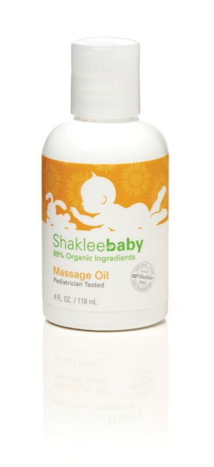
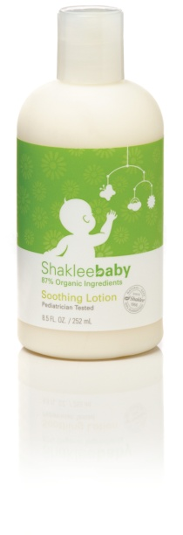
Stephanie Bruce Brayden – 4 Year Old With Eczema
Itchy, super dry skin – arms, legs , chest, back at 1 year old
Put on steroid creams and lotions .. Brayden said the creams “ hurt” .. Applied periodically over 3 years.. Sometimes every day for weeks at a time
Zyrtec prescribed and stronger steroid cream – but never filled the prescriptions at age 4 . Blood test showed no allergies.
Just started Shaklee 1 month ago … on a tight budget .. – Optiflora Probiotic Capsule, Shaklee Children’s Multi, Shaklee Baby Massage Oil, Shaklee Baby Soothing Lotion .. Improved in 4 DAYS
Next will be adding Mighty Smarts

Slide 24
Side Effects of Steroid Creams
Adrenal gland suppression – Topical steroids can suppress the production of natural steroids, essential for healthy living. Stopping the steroids suddenly may then result in illness.
Cushing syndrome – If large amounts of steroid are absorbed through the skin, fluid retention, raised blood pressure, diabetes and many other side effects may result. Permanent discoloration of the skin
Weaken immune system
Skin side effects
Skin thinning (atrophy) and stretch marks .
Easy bruising and tearing of the skin.
Rash around the mouth.
Enlarged blood vessels .
Susceptibility to skin infections, eg impetigo, herpes simplex, folliculitis
Disguising skin infection
Aggravating certain inflammatory skin conditions, particularly pustular psoriasis, steroid acne and steroid rosacea.
The risk of these side effects depends on the strength and specific steroid, the length of application, the site treated, whether it is occluded, and the nature of the skin problem.
steve

Slide 25
Psoriasis –chronic skin problem that causes skin cells to grow too quickly, resulting in thick, white, silvery, or red patches.
Normally, skin cells grow gradually and flake off about every 4 weeks. New skin cells grow to replace the outer layers of the skin as they shed.
But in psoriasis, new skin cells move rapidly to the surface of the skin in days rather than weeks. They build up and form thick patches called plaques . They most often appear on the knees, elbows, scalp, hands, feet or lower back..
Auto-immune condition--occurs when the immune system overreacts, causing inflammation and flaking of skin.
barb

Slide 26
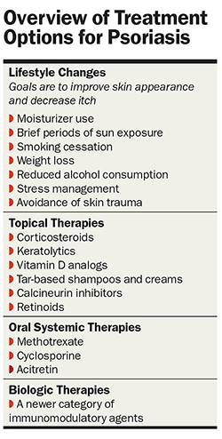
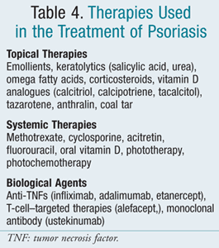
steve

Slide 27
Natural Solutions for Psoriasis Similar to Those for Eczema
Eat a natural, healthy diet.
Avoid things that can irritate the skin.
Heal the gut.
Reduce inflammation
Normalize the immune system
Provide the nutrients the skin needs
barb

Slide 28
Eczema & Psoriasis Collection for Adults
Collection for Children
Vita Lea
Omega Guard Essential Fatty Acids, CarotoMax
Optiflora Probiotic
Vitalizer ( contains 80 nutrients that benefit the skin including all the above )
GLA Complex
Protein shakes and bars
Also recommended for more severe cases especially with weakened immune system --
Nutriferon
Vivix
Incredivites Multi
Mighty Smart Chewable Omega 3’s
If infant, Omega Guard, pierced and oil squeezed out
Optiflora Probiotic Capsule, soak to soften outer layer
If needed… can add
Alfalfa Complex
Chewable C
steve

Slide 29
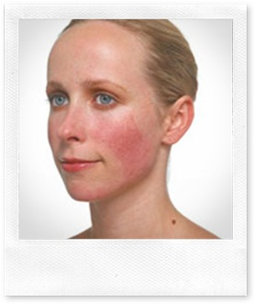
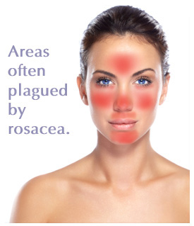
1. Heal the gut --OptiFlora 2. Reduce Inflammation GLA, and EPA 3. Provide nutrients for healthy skin and healthy immune system – Vita Lea / Vitalizer (Zinc, Vita C, Vita E, Carotenoids )
Rosacea is a very common skin disease that affects people over the age of 30. It causes redness on your nose, cheeks, chin, and forehead. Some people get little bumps and pimples on the red parts of their faces. Rosacea can also cause burning and soreness in your eyes
What are the symptoms?
A flushed, red face with sensitive, dry skin that may burn or sting.
Small bumps and pimples or acne-like breakouts.
Skin that gets coarser and thicker, with a bumpy texture.
Dry, red, irritated eyes.
barb

