Slide 1

Natural Approaches to Hormonal Imbalance
Barbara Lagoni
Dr. Steve Chaney
Hannah Sharapan
Cheryl Mangan
Beth Kaniuk

Slide 2

Most Women’s Health Issues are Caused from Hormonal Imbalance and Estrogen Dominance
Dr Margaret Christensen

Slide 3
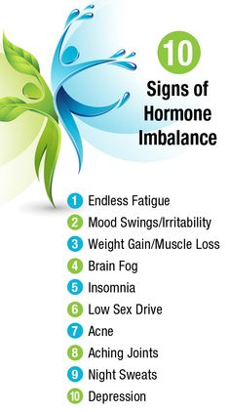
barb

Slide 4
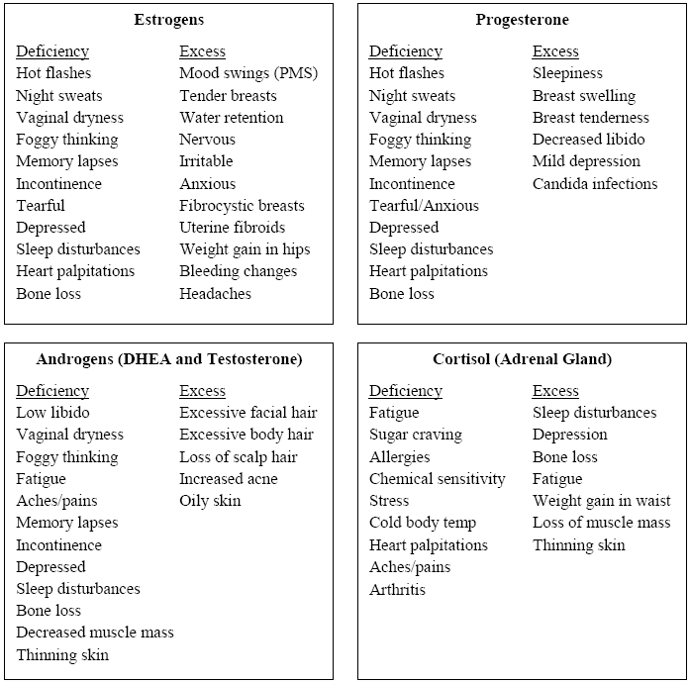
barb

Slide 5
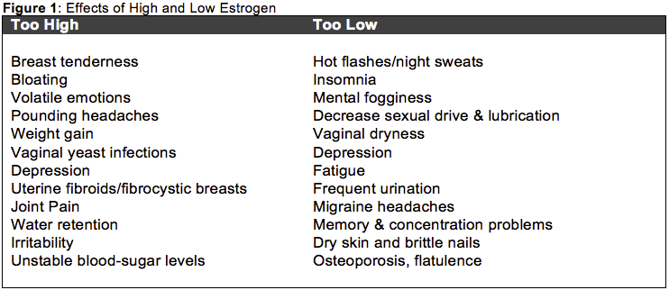
When Estrogen is Too High
When Estrogen is Too Low
barb

Slide 6

Side Effects of Hormonal Medications
Hormone Replacement Therapy
Increase risk of cancer particularly breast and endometrial.
Increase risk of blood clotting leading to heart attack and stroke.
Increase risk of gallbladder disease.
Birth Control Pills
Depression
Migraines
Breast Lumps
Heavy bleeding between periods.
Increased blood pressure. Increased cholesterol.
Blood clots in legs or lungs may cause heart attack or stroke.
Liver damage. steve

Slide 7
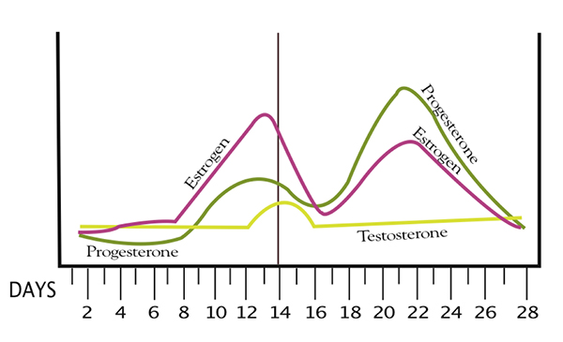
It’s Complicated – Progesterone Balances Estrogen
steve

Slide 8
It’s Complicated – All Our Body Systems Interact
Hormones
Gut
Brain
All Interact
Candida
Bad Bacteria
Gluten
Bad Diet
Stress
Anxiety
Depression
Lack of Sleep
Inflammation
Obesity
High Fat Diet
Infection
steve

Slide 9
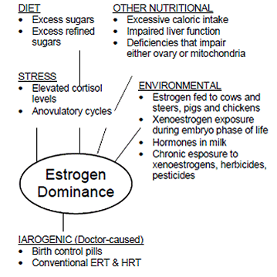
steve

Slide 10
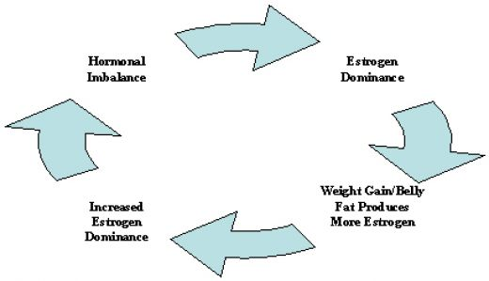
Hormonal Imbalance
Estrogen
Dominance
Weight Gain/Belly Fat
Produces More Estrogen
Increased
Estrogen
Dominance
steve

Slide 11
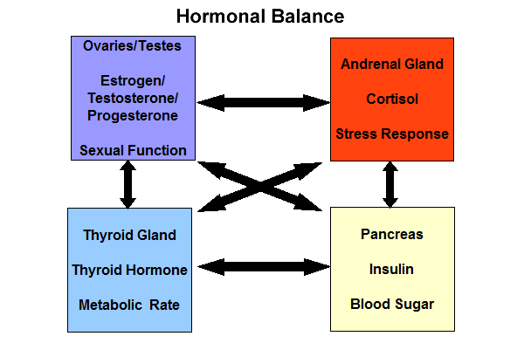
It’s Complicated – All Our Hormones Interact
steve

Slide 12
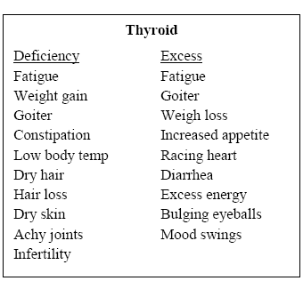
steve

Slide 13
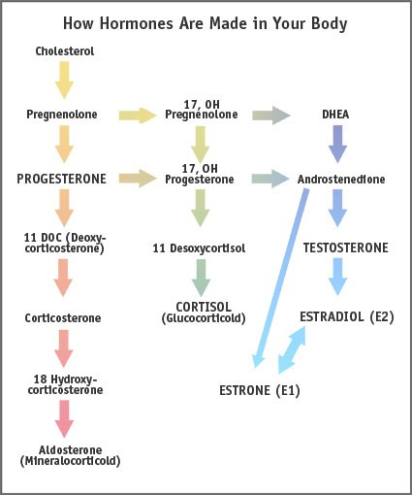
Our Adrenals Do A Lot.
They Produce…
Cholesterol
DHEA
Aldosterone – maintains fluid balance
Progesterone
Cortisol – is our stress hormone
Cortisol
Estradiol
The DHEA Pathway – is important for health & reproduction
Estrone -menopause
Aldosterone
steve

Slide 14
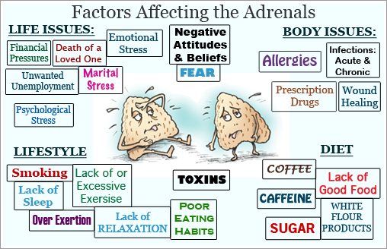
barb

Slide 15
Common Symptoms of Adrenal Exhaustion
Difficulty getting up in the morning ,never feeling well-rested, even after sleep
Nocturnal waking
Anxiety, nervousness, mild depression
Lightheadedness on standing
Low blood pressure (hypotension)
Salt cravings
Reliance on sugar and caffeine to bolster flagging energy
Problems coping with stressful situations
Frequently feeling angry and frustrated
Struggling to get through the day, but feeling better after an evening meal
Frequent infections
Abdominal weight gain
Hair loss
Acne
Cold intolerance
Lack of mental focus, decreased productivity, absent-mindedness barb
Feeling like everything’s “too hard”

Slide 16
Hormonal Imbalance Stories
Let’s look at what has worked for other women.

Slide 17

Cheryl Mangan’s Severe PMS
Late 30’s – Ultra Sound Technician
Mood Swings
Headaches, heavy bleeding .. Kept getting worse
Breast tenderness, really bad mood swings .. Irregular cycles
Doctors recommended birth control pills, hormonal replacement, drugs for anxiety, …
Cheryl was aware of side effects and refused
Worked full time, 2 pre-teen boys, parents became ill, .. And then Tom brought home a puppy !
Eventually lead to Hot flashes, night sweats
Age 41 – doctors still only offering medications and then she discovered Shaklee .. First person who asked her about her life, diet and stress.

Slide 18

Megan Densmore Ovarian Cysts, Polycystic Ovarian Syndrome
Diagnosed with Fibromyalgia at age 13
I started on Shaklee products at 27 years old and had a complete
reversal of my fibromyalgia symptoms in around 3-6 months.
After 1 year on Shaklee products I decided to try going off birth control. I have a history of PCOS - possibly related to the fibromyalgia - and was put on birth control at 18 in order to manage this. I have had laproscopic surgery for cysts in the past and the one time I tried going off birth control when I was 24 landed me in the emergency room with a cyst.
I added 2 GLA per day to everything else I was taking 2 years ago and went off the birth control. My cycles regulated within a few months. No cysts since, but I had increased PMS symptoms and I started experiencing pretty bad acne after going off birth control.
I am now 2 years off of birth control, no cysts, regular cycles and I added a 3rd GLA per day a couple months ago (up from 2 per day) to see if my skin would clear and it has. I am also noticing much less cravings for dark chocolate (my vice) and greatly reduced PMS. It could be a fluke but my chronic eye dryness has also improved. Everything else in my supplement regimen/diet has stayed the same. hannah

Slide 19

Beth Kaniuk – Polycystic Ovarian Syndrome, No Ovulation, No Periods
1 year of fertility treatment – Clomid ( gained 10 pounds, often called “ crazy pills” ), Follistim shots to stimulate egg production
Husband low sperm count
Twins born
At 8 months old, replaced all toxic cleaners with Get Clean products
Mike started on Vitalizer for Men
Beth started on Vitalizer for Women, Energizing Soy Shakes
At 13 months – pregnant with Baby Logan .. Added B Complex, Shaklee 180 Smoothees, Performance Hydration Drink, and Vita C or Garlic
Chewable Calcium LIFE SAVER – for heart burn!!!
Difference in pregnancy – With Shaklee more energy ( amazing with 3 under 2 years old ) , no fluid retention ! ( last month with twins gained 20 pounds from water weight .. Hospitalized 2 days ), no leg cramps … AND
On Shaklee 180 bars and smoothees, returned to normal weight within 6 weeks! .. Stopped carb cravings that contributed to PCOS.
Ginny ‘s story – irregular cycles, 2 miscarriages, difficulty conceiving, 1 month after Vitalizer and GLA .. PREGNANT !

Slide 20
JoAnn Poole – Uterine Fibroids
Terrible pain before and during periods; Doctor recommended hysterectomy
Decided to try Shaklee supplements and dietary changes first.
Results -- After 1 month -- no pain … After 3 months -- fibroids gone
Doctor attributed the results to the supplements.
Vitalizer ( Vita E, Zinc, CarotoMax. Omega 3 FA, Vita C took separately then )
Osteo Matrix ( calcium and minerals for bone density )
GLA B Complex
Energizing Soy Protein or Shaklee 180 Smoothees. Several times a day
Marilyn Garapolo – at age 49, serious heavy bleeding, diagnosed with 3 fibroids the size of grapefruits, hysterectomy recommended..8 months on candida diet, removing all sugar and refined carbohydrates, 6 to 9 vegetables a day and supplements above. Fibroids shrunk. .. And lost 20 pounds ! hannah

Slide 21
Sandi Soper –
Severe Menstrual Bleeding
Eileen Neusome – Hot Flashes
Was scheduled for minor surgery and doctor told her to stop all vitamins for 3 days
Within 3 days her hot flashes returned
She resumed her Shaklee regimen … hot flashes gone
Vita Lea Multi
B Complex
GLA
Menopause Balance Complex
Energizing Soy Protein or Shaklee 180 Smoothees cheryl
Vitalizer with Iron
Menopause Balance Complex
Shaklee 180 Soy Smoothees

Slide 22
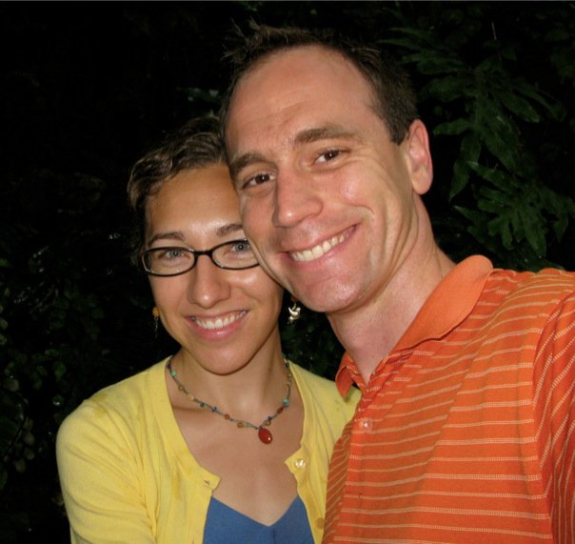
Andrea Hoglund –Heavy Menstrual Periods and Break-Through Bleeding, Anemic, Fainting
Andrea would have long heavy periods lasting 7 days . Then 4 or 4 days later, heavy bleeding would resume.
She eventually became anemic…. And then fainting spells began.
Doctors recommended initially birth control pills and then a hysterectomy. Andrea was 33 years old.
Kylie recommended:
Vitalizer with Iron
Iron Plus C
GLA
B Complex
Periods are now 3 days – no cramps, no PMS
Kylie HInkle

Slide 23
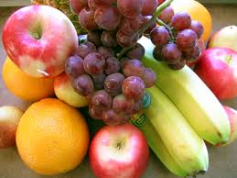
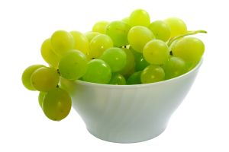
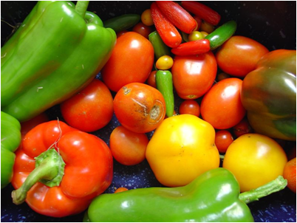
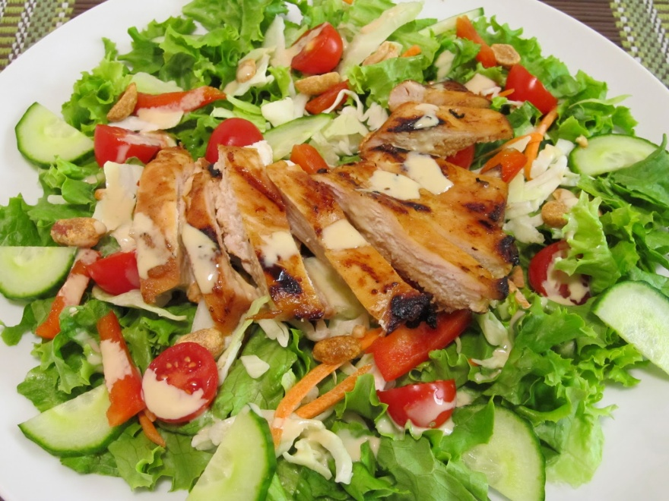
Eat Healthy Food …
First Step to Balancing Hormones
Whole natural
real food
barb

Slide 24
Supplements To Help Balance Hormones
Optiflora Probiotics ( Candida )
B Complex (Balance Hormones)
Vita E (Inflammation)
Vita C (Health of Adrenals)
CarotoMax (Inflammation)
Omega Guard (Inflammation)
Soy Protein – energizing Soy Protein or Shaklee 180 Smootheee and Bars (Heal the Gut, Healthy Organs)
GLA (Balance Hormones)
Menopause Balance Complex (Balance Hormones)
Liver DTX (Clear Excess Hormones) barb
Vitalizer -- Daily Vitamin Strips

Slide 25

Unique, Patented “Triple Encapsulation” Technology Protects “Live” Microflora
Supports healthy immune system
& healthy digestion
“Live” microflora
Water and oxygen barrier
Stomach acid protection
Only Shaklee has it!
500 million friendly bacteria/capsule
Triple encapsulation process → 90% delivery
OPTIFLORA™ completely survives stomach acid. Microflora are then released in the intestine. steve

Slide 26
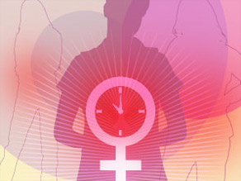
B Complex
Essential for brain and nervous system (mood swings, Irritability, nervousness, mental confusion, depression, dizziness, trembling )
Depleted by sugar, alcohol, caffeine, refined carbs, medications, stress .. In other words .. Just about everything ! )
Helps balance hormones ( PMS, morning sickness, prevention of birth defects, cervical dysplasia )
Helps regulate blood sugar ( alleviates carb and sugar cravings, hypoglycemia symptoms, etc)
Essential for formation of healthy red blood cells and protective antibodies.
Reduces risk for heart disease, reduces homocysteine levels,
Insomnia, hair loss, cracks at corners of mouth, normal growth in children ) barb

Slide 27
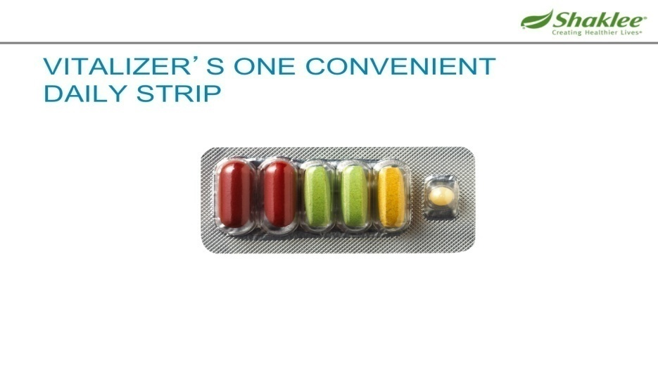

Shaklee Vitalizer™
Dietary Supplement
People report increased energy, improved immunity, steve
80 bio-optimized nutrients
clinically proven to create a foundation for a longer,
healthier life*
Vitality Guaranteed. 100%.
*These statements have not been evaluated by the Food and Drug Administration.
These products are not intended to diagnose, treat, cure, or prevent any disease.

Slide 28
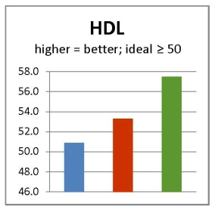
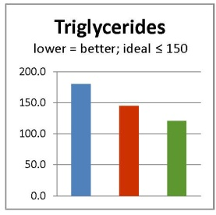
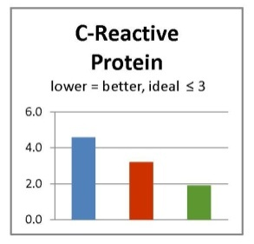
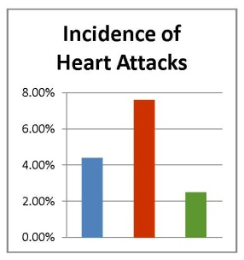
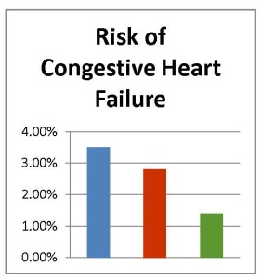
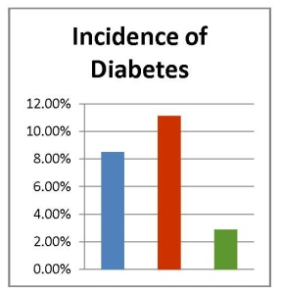
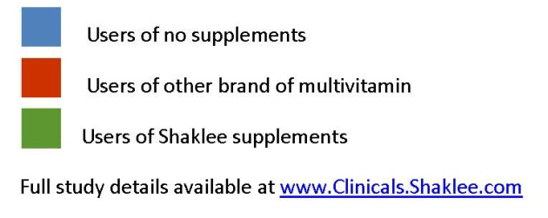
The Landmark Study – the Genesis of Vitalizer
completely independent study performed by Dr. Gladys Block of UC Berkeley
published Journal of Nutrition, 2007
Compared…
  people who used Shaklee products for 20 years
  people who used multivitamins for 20 years
  people who used no supplements steve
Nobody in the Shaklee
group (average age =
65) had elevated CRP
or triglycerides
Markers of disease risk
The groups were
matched for age,
weight, gender &
ethnicity
The only difference was
The products the
Shaklee group was using
Disease outcomes
Nobody else has this
kind of proof that their
products actually
improve health!

Slide 29

A Word About Soy
Fears raised about soy and breast cancer -- based on animal studies (and those are mixed)
Multiple clinical studies show consumption of soy reduces the risk of developing breast cancer.
But what about women who have had breast cancer?
A recent study with 5,000 subjects asked that question
Breast cancer survivors with highest soy intake had:
25% less chance of breast cancer recurrence
25% less chance of dying from breast cancer
Shu et al, JAMA, 302: 2437-2443, 2009 steve
Notes:
29

Slide 30
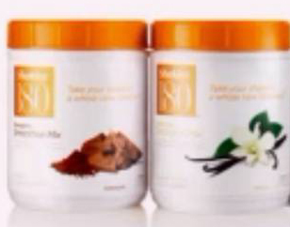
Where to Start --
Best Breakfast on the Planet ..
Shaklee 180 Smoothees and Vitalizer™
Dietary Supplement
80 bio-optimized nutrients clinically proven to create a foundation for a longer, healthier life*
Vitality Guaranteed. 100%.
barb

Slide 31

GLA – Omega 6
Gamma Linolenic Acid
  Blocks prostaglandins which cause menstrual cramps and bloating. Helps correct hormonal imbalance.
  Women report reduction in PMS symptoms
  Reduction in hormonal headaches
  Reduction in menopausal symptoms
  Additional benefits:
  Reduces inflammation associated with rheumatoid conditions, eczema, cradle cap.
  Reduces tremors associated with Parkinson’s Disease
  Halts diabetic neuropathy
  Supports immune system barb

Slide 32
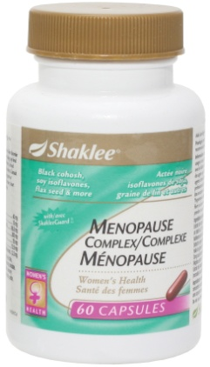
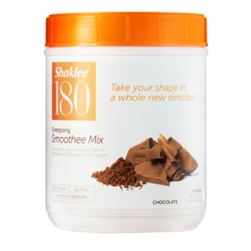

Menopause Balance Complex
Evidence of the value of isoflavones in
menopausal stages comes in part from studying women in countries where consumption of soy is high.
In Asia, where consumption of isoflavones from a variety of soy foods is estimated to be in the range of 20–80 mg per day, women report a smoother transition through menopause than women in Western cultures,
where soy is consumed only at about 1–3 mg per day

Slide 33
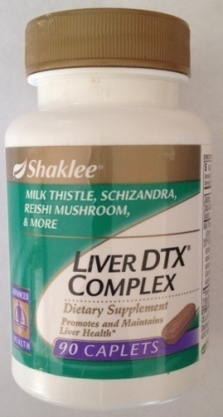
Liver DTX Complex – Milk Thistle, Schizandra Extract, Dandelion, Reishi Mushroom, Turmeric, Artichoke
ü
Liver is filtering organ for the blood
Liver manufactures essential hormones
Helps detox the liver naturally
Helps improve bile flow to eliminate compounds detoxified by the liver. ( including excessive hormones )
Helps repair and regenerate liver cells (Take 1 in AM, 2 in PM)
Antioxidants help protect liver cells
Important for anyone taking daily medications.
Food poisoning
Elevated liver enzymes/ liver damage, hepatitis
Exposure to pollution,hazardous chemicals ( painting, pesticides, herbicides, etc)
Excessive alcohol consumption
Reduces risk of gall stones
Helps lower cholesterol barb

Slide 34
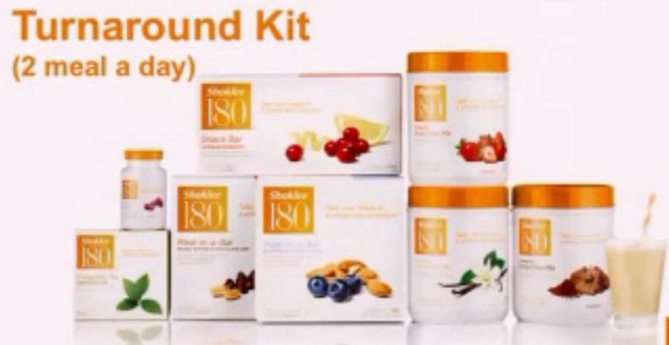

The Shaklee 180 Turnaround Kit
Smoothee Mix
Meal-In-A-Bar
Snack Bars
Energy Tea Mix
Metabolic Boost
Free Web Support
  Meal planning
  Tracking features
  Online support groups
  Dietitian to answer questions
  Online Exercise Instruction
Obesity can cause
Estrogen dominance which can lead to
Hormonal imbalance
Blood sugar swings
Increase risk for diabetes, heart disease and cancer steve
Notes:
34

Slide 35
Supplements To Help Balance Hormones
Optiflora Probiotics ( Candida )
B Complex (Balance Hormones)
Vita E (Inflammation)
Vita C (Health of Adrenals)
CarotoMax (Inflammation)
Omega Guard (Inflammation)
Soy Protein – energizing Soy Protein or Shaklee 180 Smootheee and Bars (Heal the Gut, Healthy Organs)
GLA (Balance Hormones)
Menopause Balance Complex (Balance Hormones)
Liver DTX (Clear Excess Hormones) barb
Vitalizer -- Daily Vitamin Strips

Slide 36

When Momma Ain’t Happy… Ain’t Nobody Happy
So here’s to… happy healthy mommas everywhere!

Slide 37
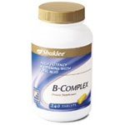
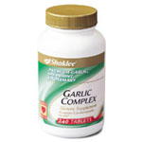
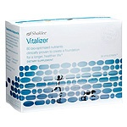
For Hormonal Imbalance .. Start here
Candida – big cause …Overgrowth of yeasts in intestines. Estrogen should be excreted through intestinal tract when it is healthy. If not, it is reabsorbed and estrogen levels get too high.
Recommended :
  Vitalizer ( contains Optiflora, B Complex,
  Multi, Omega 3, 80 nutrients )
  Garlic – helps kill candida yeasts
  GLA- blocks prostaglandins which cause
  menstrual cramps and bloating
  B Complex ( might want extra )

Slide 38


Slide 39
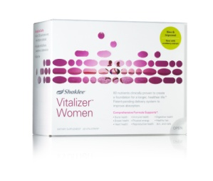

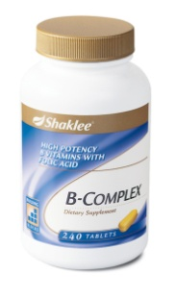
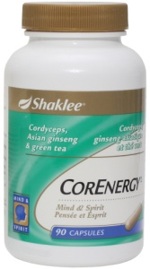
Adrenal Exhaustion Collection
Vitalizer
Shaklee Soy Protein Shakes and Smoothees
Then add:
Vita C – Vitamin C is drained from adrenals under stress because it is needed to make cortisol
B Complex -- depleted by stress
CorEnergy – Ginseng and Cordyseps are adaptogens that help glands normalize
barb

Slide 40
For Hormonal Imbalance .. Start here
Candida – big cause … estrogen should be excreted through intestinal tract when the digestive tract is healthy. If not, it is reabsorbed and estrogen levels get too high
Recommended :
  Vitalizer ( contains Optiflora, B Complex,
  Multi, Omega 3, 80 nutrients )
  Garlic – kills candida yeasts
  GLA- blocks prostaglandins which cause
  menstrual cramps and bloating
  B Complex ( might want extra )
  Energizing Soy Shakes or Shaklee 180 Smoothees

Slide 41
Effects of Excess Estrogen
Progesterone Balancing Effects
Stimulates fast-multiplying cells in uterine lining
Causes breast stimulation
Increase body fat
Depression and headaches
Salt and fluid retention
Interferes with thyroid function
Increase blood clotting
Decrease sex drive
Impairs blood sugar control
Loss of zinc and retention of copper
Reduces oxygen levels in all cells
Increases risk of endometrial cancer
Increases risk of breast cancer
Reduces strength of blood vessels
Maintains nourishing uterine lining
Protects against fibrocystic breasts
Helps use fat for energy
Natural anti-depressant
Natural diuretic
Facilitates thyroid hormone action
Normalizes blood clotting
Restores sex drive
Normalizes blood sugar levels
Normalizes zinc and copper levels
Restores proper oxygen levels
Helps prevent endometrial cancer
Helps prevent breast cancer
Restores strength of blood vessels

Slide 42
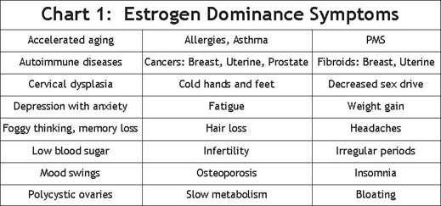
Esr

Slide 43
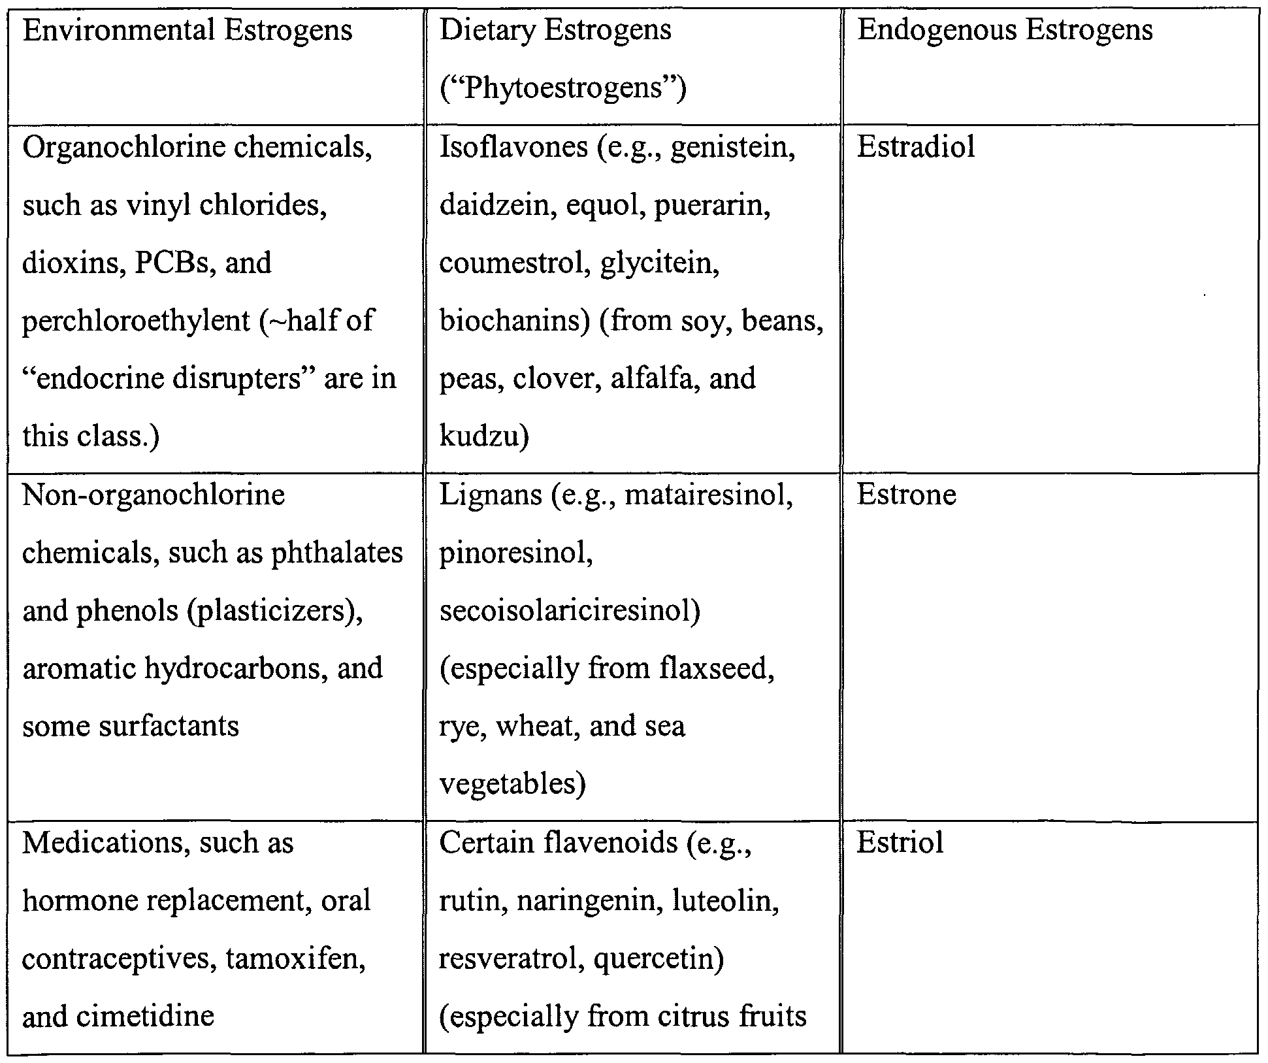

Slide 44


Slide 45


Slide 46
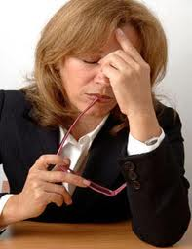
Side Effects of Anti-Depressants
Prescribed for 1 out of 10 Americans
Headache Nausea
GI Track upset Agitation
Anxiety Dizziness
Dry mouth Blurred vision
Constipation Sleep Disruption
Weight gain

Slide 47
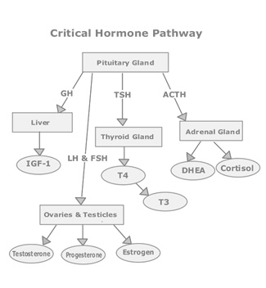
Glands Produce Hormones and Their Activity is All Inter-Related
That’s why a holistic approach – that seeks to provide essential nutrients needed to repair and rebuild cells all over the body is a good starting place.

Slide 48
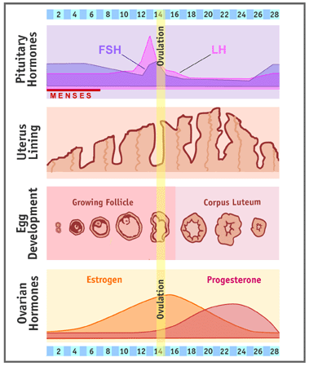

Slide 49
